Slide 1

Customer Shopping Behavior Analysis
Examining 3,900 purchase records to uncover actionable insights on spending patterns, customer segmentation, and product performance.

Slide 2
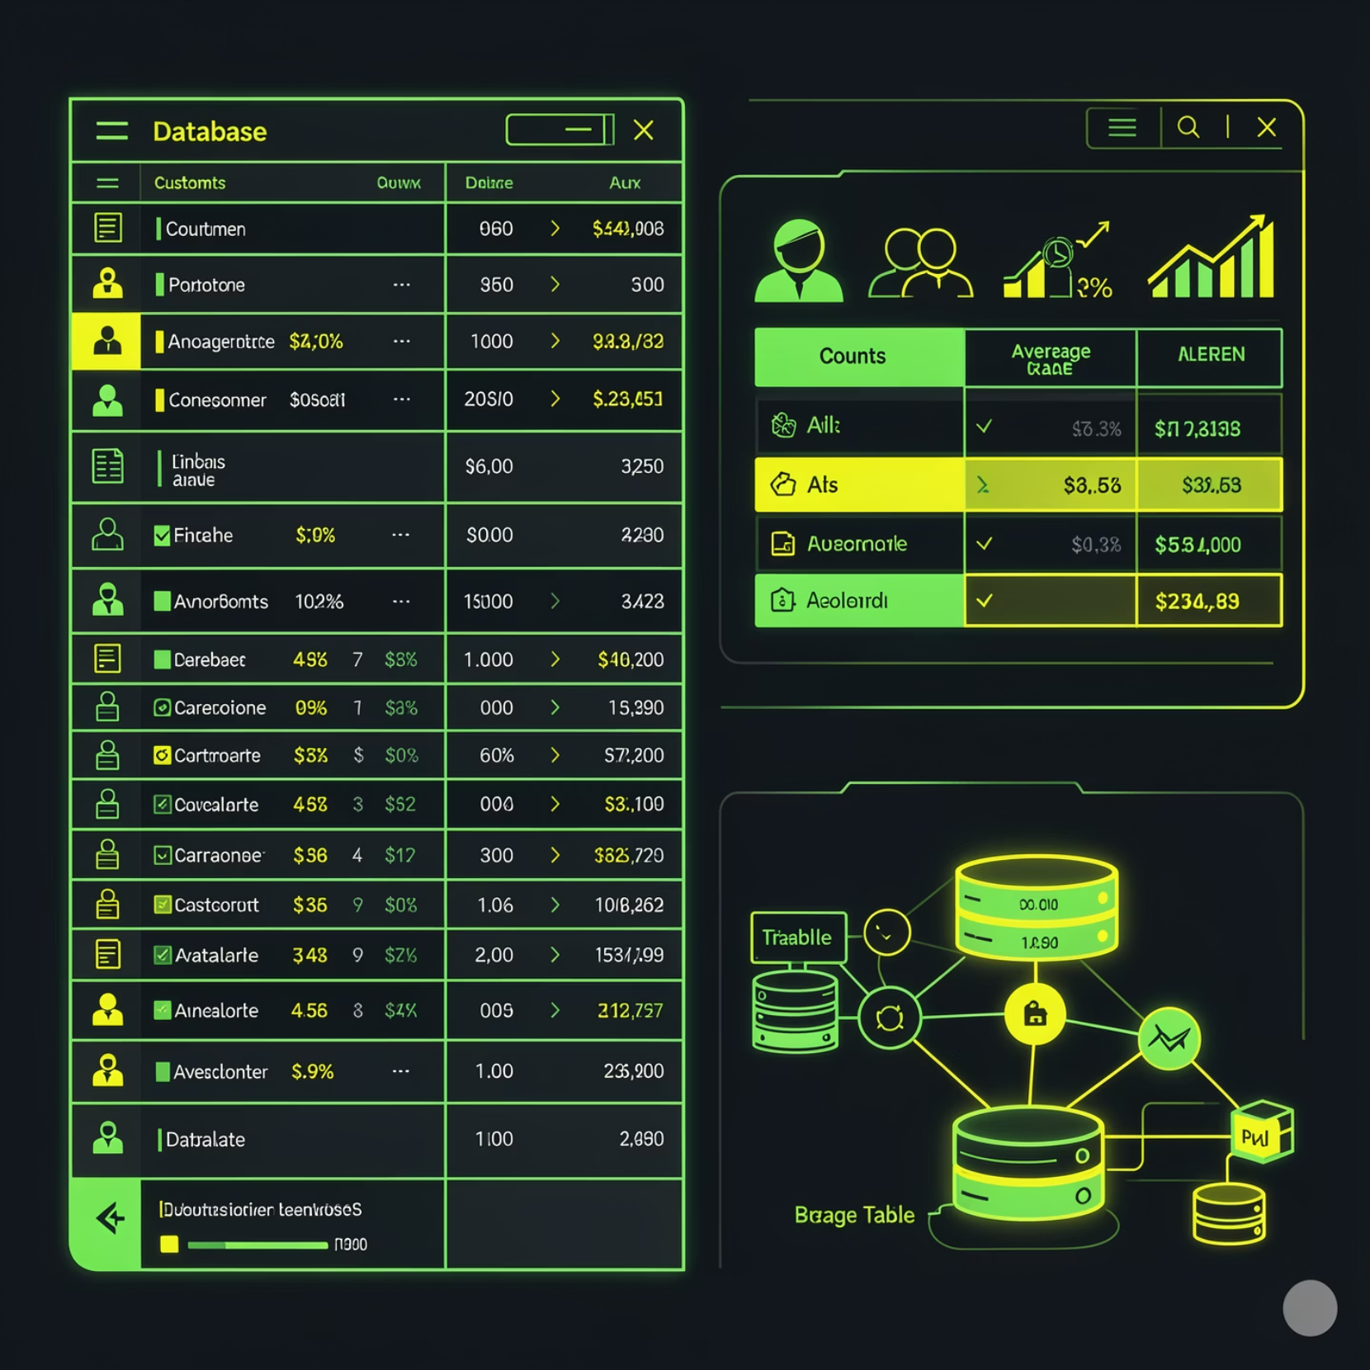
OVERVIEW
Project Scope & Dataset
Comprehensive Transaction Data
Analysis of 3,900 transaction records across 18 structured variables capturing customer demographics, purchase characteristics, and behavioral indicators.
Customer attributes: age, gender, location, subscription status
Purchase details: categories, amounts, seasonal trends, preferences
Behavioral metrics: discount usage, frequency, reviews, shipping

Slide 3
PYTHON ANALYSIS
Data Preparation & Exploration
01
02
Data Loading & Exploration
Missing Data Handling
Imported dataset using Pandas, examined structure with df.info() and summary statistics with df.describe().
Identified and imputed missing Review Rating values using median rating per product category.
03
04
Feature Engineering
Database Integration
Created age_group column by binning ages and purchase_frequency_days from purchase data.
Connected to PostgreSQL and loaded cleaned DataFrame for SQL analysis.

Slide 4
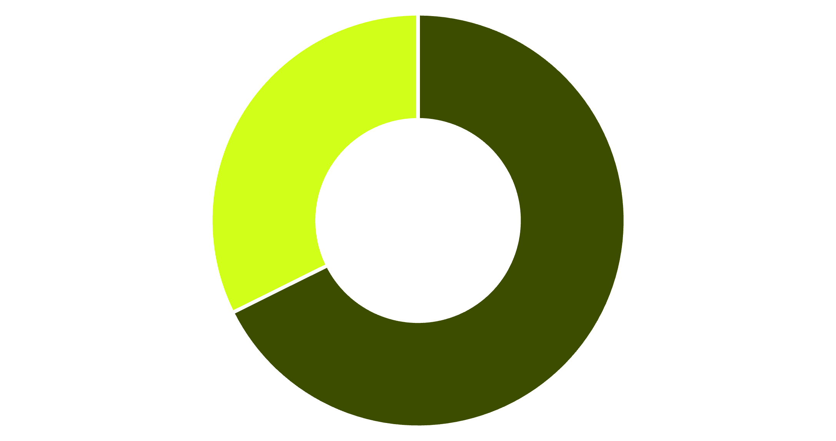
SQL INSIGHTS
Revenue Analysis by Gender
Male Customers Drive Revenue
Male customers contribute $157,890 in total revenue compared to $75,191 from female customers—representing 68% of total sales.
This demographic insight suggests opportunities for targeted marketing strategies.
Male
Female

Slide 5


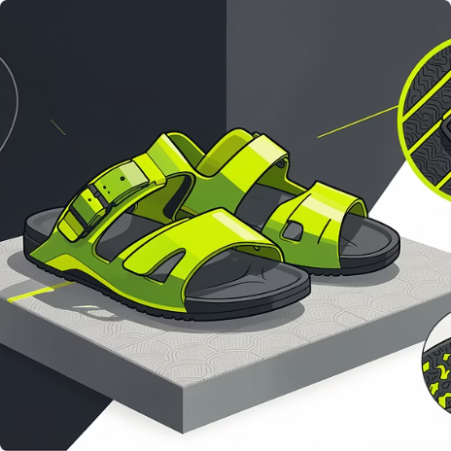
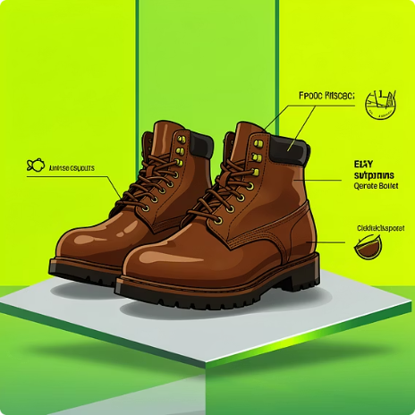
Product Performance Insights
Gloves
Hat
Sandals
Boots
Top-rated product with 3.86 average review rating
Strong performance at 3.80 rating with 50% discount dependency
High customer satisfaction with 3.64 average rating
Solid performer at 3.52 rating in footwear category

Slide 6
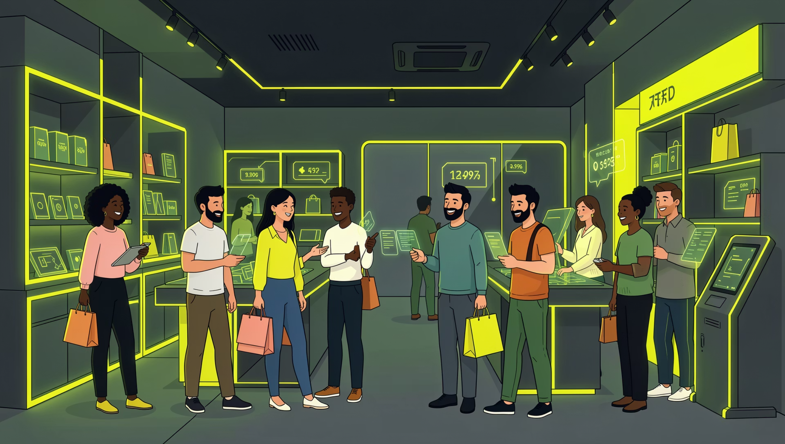
Customer Segmentation Analysis
Purchase Behavior Patterns
Customer base segmented by historical purchase activity reveals strong loyalty trends:
Loyal Customers
Returning
New
3,116 customers (80%)
701 customers (18%)
53 customers (1%)

Slide 7
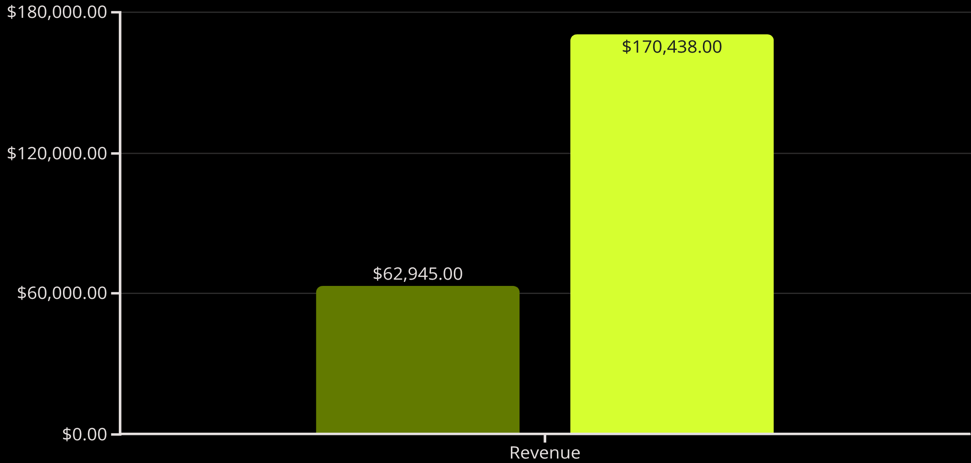
Subscription & Shipping Insights
Subscription Opportunity
Only 27% of customers are subscribers (1,023 vs 2,847 non-subscribers), yet average purchase amounts are nearly identical ($59.49 vs $59.87).
Express shipping commands higher average purchase value ($60.48) compared to standard shipping ($56.46).
Subscribers
Non-Subscribers

Slide 8

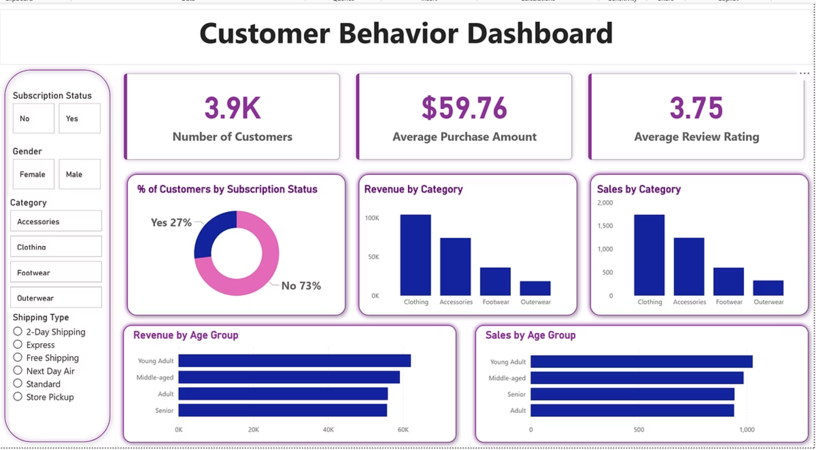
Power BI Dashboard
Interactive visualization platform developed to explore customer trends, revenue performance, and segmentation outcomes with dynamic filters and KPIs.
3.9K Customers
$59.76 Avg Purchase
3.75 Rating
Total customer base analyzed
Mean transaction value
Average customer review score

Slide 9
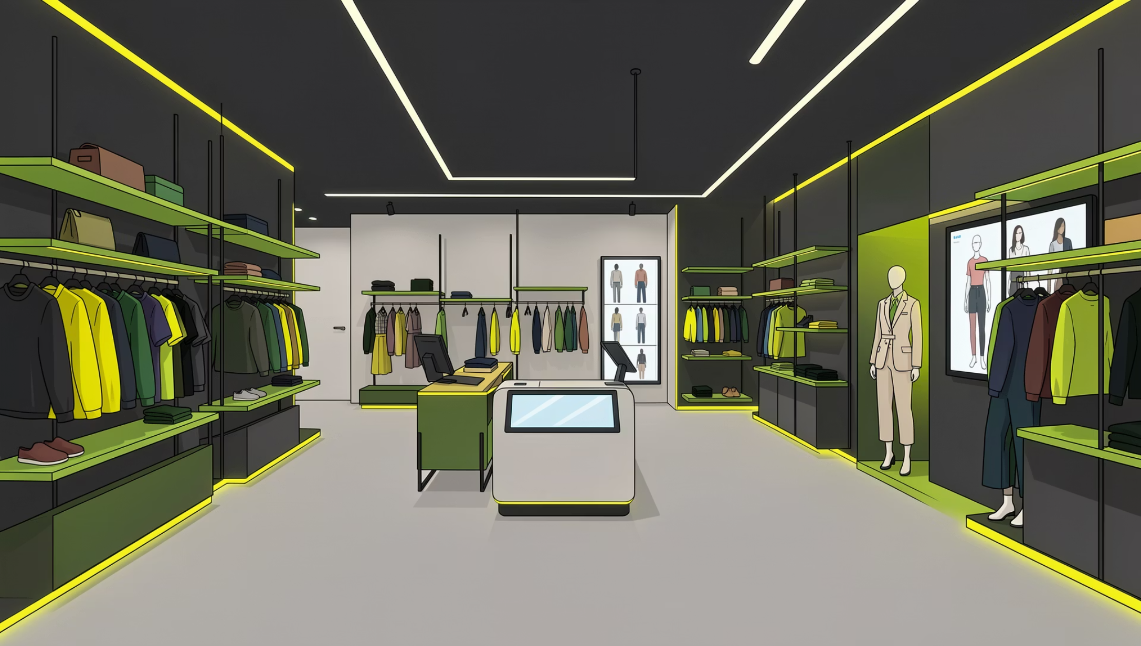
Category Performance Breakdown
Revenue Leaders
Clothing dominates with top-selling items:
Blouse: $10,410 revenue leader
Shirt: $10,332 strong performer
Dress: $10,320 consistent seller
Accessories follow with Jewelry ($10,010) and Sunglasses ($9,849) leading the category.

Slide 10

RECOMMENDATIONS
Strategic Business Actions
Strengthen Subscription Programs
Implement Loyalty Strategies
Introduce exclusive incentives and personalized benefits to increase the 27% subscription rate and drive recurring revenue.
Develop reward programs targeting the 80% loyal customer base to maximize lifetime value and retention.
Optimize Discount Strategies
Deploy Targeted Marketing
Reevaluate promotional policies for high-dependency products like Hats (50% discount rate) to balance sales growth with margins.
Focus campaigns on high-revenue segments and top-rated products to improve conversion efficiency and ROI.

